Slide 1
Excel Lab
Frequency Table
Bar/Pie Chart
Histogram
Grouped Frequency Table
Dr. Abolfazl Saghafi
Assistant Professor of Statistics & Data Science
Data Science Program Director

Slide 2
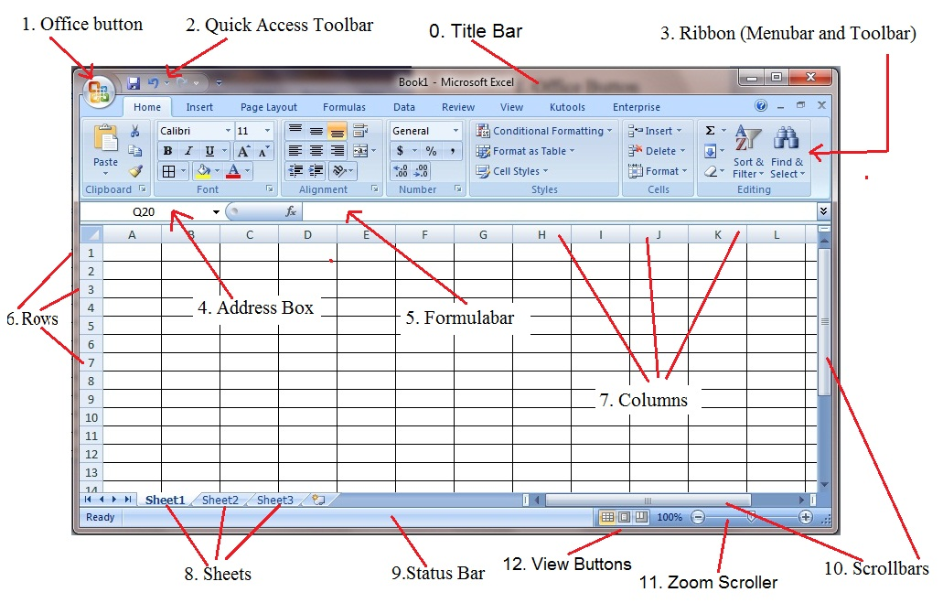
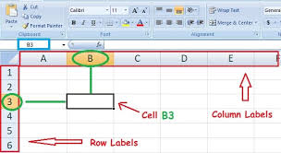
Microsoft Excel is a Spreadsheet featuring calculation, graphing tools, pivot tables, and a macro programming language.
Data are entered in Cells, named by their Column and Row labels.
Each cell either contains data entered directly or data computed using other cell’s values.
Good Tutorial on Excel Beginner:
https://www.youtube.com/watch?v=rwbho0CgEAE
Notes:
If you’re a beginner in Excel, watch that YouTube video
Download and open Class Survey data from blackboard in Excel

Slide 3
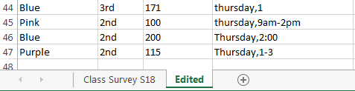
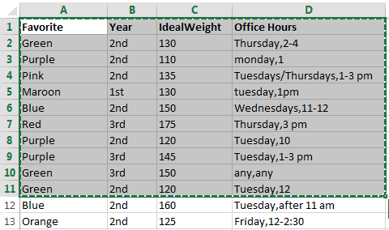
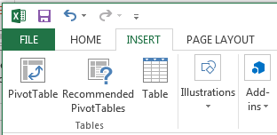
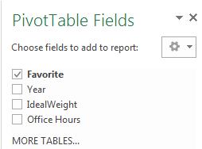
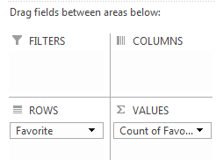

Quick Frequency Table
Open the class survey dataset,
Go to Cleaned Tab,
Select ALL the data eateries (CTRL+A)
Go to INSERT Menu and Select Pivot Table
Don’t change anything
hit OK
(⌘+A) for Mac
Select Favorite and Drag it to ROWS, Select Favorite and Drag it to VALUES. Frequency Table appears!
VALUES should be based on Count
$$⇒$$
Notes:
If you have a Mac, you can find the “Pivot Table” option in “Data” menu, everything else is the same as above instructions
CTRL for Mac users is Command (or CMD) ⌘, So CTRL+A can be done using CMD+A
Some other useful shortcuts for Windows and Mac are
Action Windows Mac
Save CTRL+S CMD+S
Copy CTRL+C CMD+C
Paste CTRL+V CMD+V

Slide 4
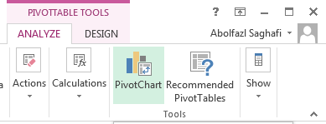
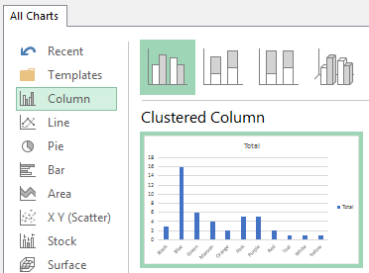
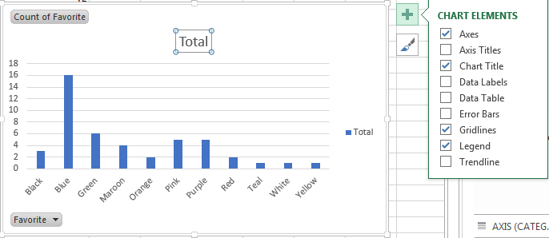
For Bar/Pie Chart (Windows & Mac)
After generating a table with Pivot Table tool, Click on Pivot Chart from PivotTable Menu
Select an appropriate chart to graph it for the data, easy as pie!
Write a proper title for the Chart
Click on the “+” sign and checkmark data labels
Select the legend (blue square with text Total) and delete it
Right Click on the chart and Select
Format Chart Area to Edit the Chart
(Change Color/Gap/Gridlines …)
Notes:
Another easier was to graph a bar/pie chart is to use Recommended Charts.
1. Select the Name of the variable and the data column
2. Go to Insert and Select Recommended Charts
3. The Barchart will be in the recommendation list, select it, it will generate both the table and the chart. You can now edit the table entry names and it will be changed in the graph. It is best if you change the variable name and entries in the generated table accordingly.

Slide 5
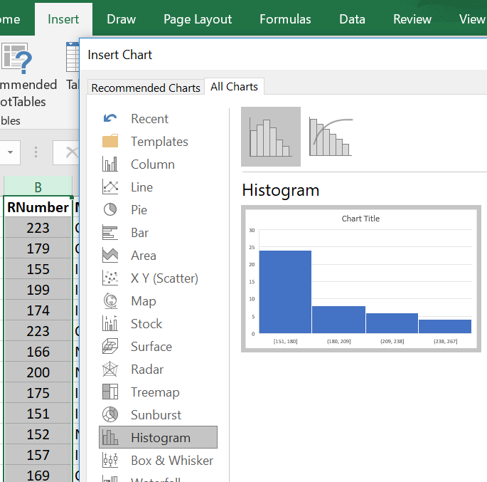

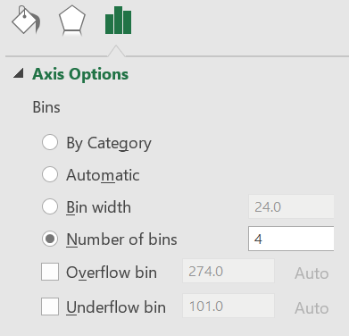
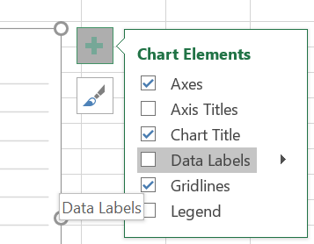
An easy way to graph a Histogram is to
Select the continuous variable and its data entries (“RNumber” here)
Go to Menu Insert
Select Recommended Charts
Go to Tab All Charts
Select Histogram
Hit OK
To change the number of categories, Right click on the x-axis values and select Format Axis
On the new window change the number of bins accordingly
Do add the x and y axis labels, you can add them by clicking on the “+” sign
Do include a descriptive title
Notes:
This works for both Windows and Mac

Slide 6
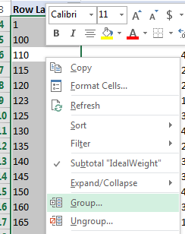
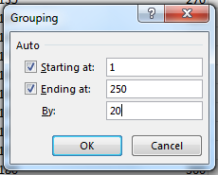
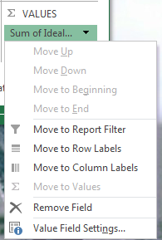
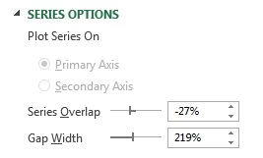
For Histogram, repeat the process to have the Pivot Table, Drag RNumber Variable into ROWS and VALUES to have its Frequency Table
Right Click on any of the values on the Row Labels and Select Group (should select ONLY one cell)
Select an appropriate number for BY to have the desired number of classes, selecting 20 creates 8 classes
The VALUES section should be based on COUNTS, if it is not, click on it, select Value Field Setting, then select count
You have the Frequency Table Now
Graph a Bar Chart using Pivot Chart
Right Click on any of the bars and select Format Data Series
In the SERIES OPTIONS place 0 for Gap Width
to change Barchart to a Histogram
Add the Axis labels and title of the graph
Make the Graph a UNIQUE one by editing it
Notes:
A second way to generate histograms that generates a frequency table first is given here

Slide 7
Practice Lab
You can find Brain Cancer Dataset in the Project folder. This data shows Brain Tumor size (mm) for a sample of Male and Female patients at different age groups and different marital status.
1) Determine the type of variables in Brain Cancer Dataset and their level of measurement.
2) Generate a frequency table and a proper chart for variable Marital Status.
3) Generate a histogram for variable Tumor Size
3) Generate a grouped frequency table with 9 groups for variable Tumor Size
Notes:
There are Practice Datasets in the Project folder
Do practice as this a VERY important skill

